Slide 1
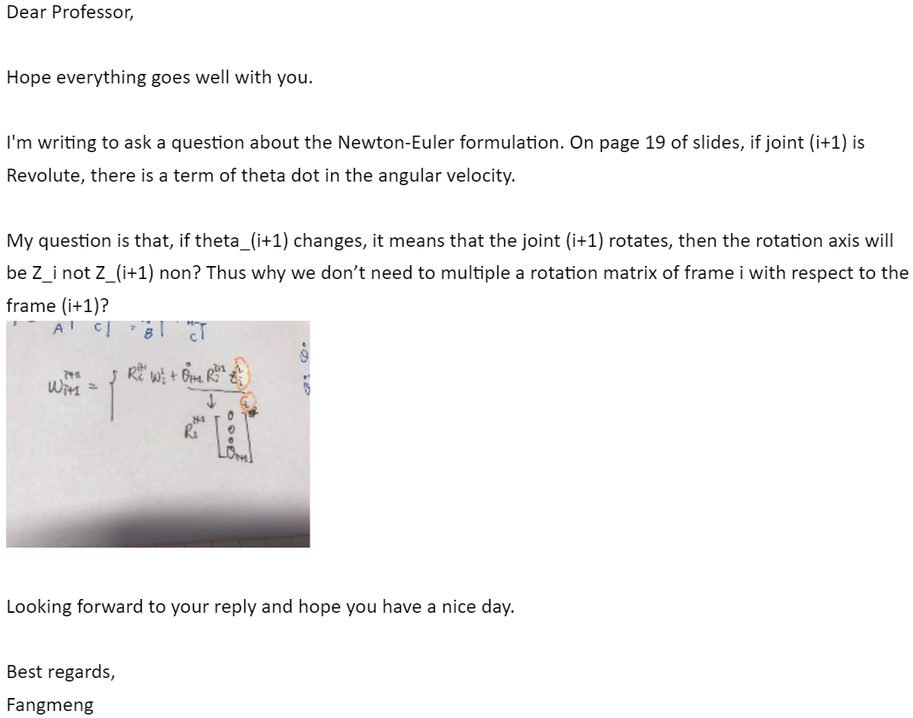
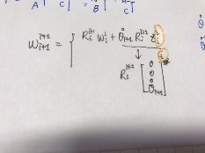
Q&A.1
Question:

Slide 2
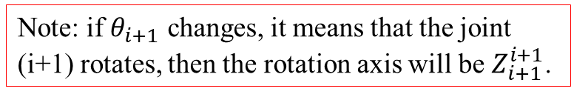
Q&A.1
Answer:
lecture note 2.1 Newton-Euler formulation p19
Forward-Backward Algorithm
Note: if $θ_{i+1}$ changes, it means that the joint (i+1) rotates, then the rotation axis will be $Z_{i+1}^{i+1}$.
is the direction vector of the rotation axis of the joint i+1 in the coordinate system i+1.
is the transformation matrix of the coordinate system.

Slide 3

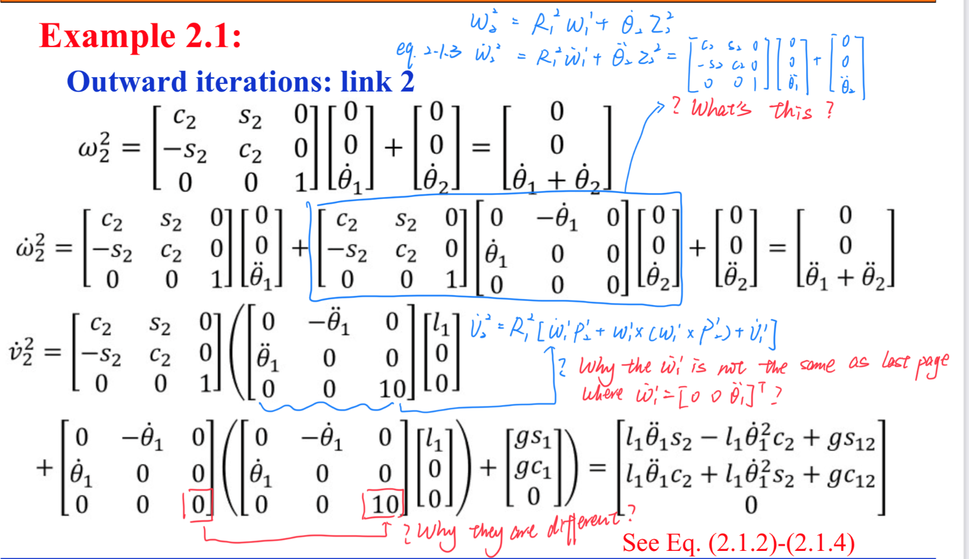
Q&A.2
Question:

Slide 4
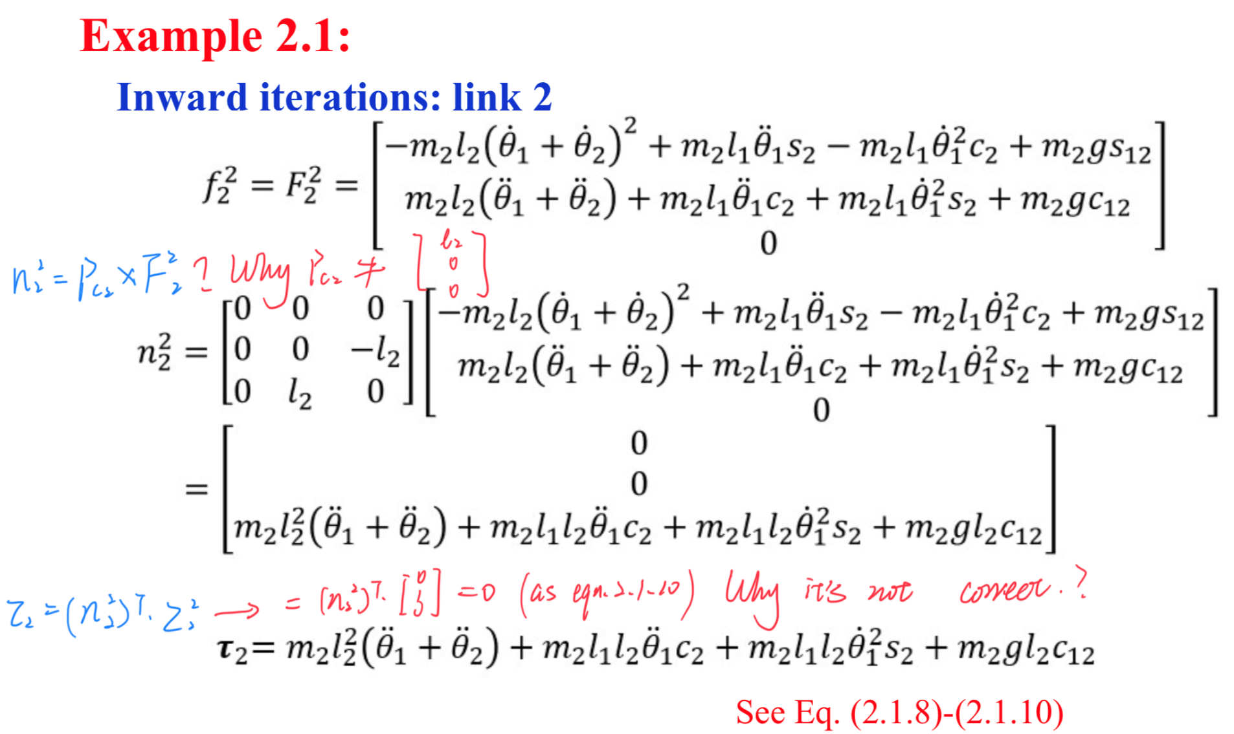
Q&A.2
Question:

Slide 5
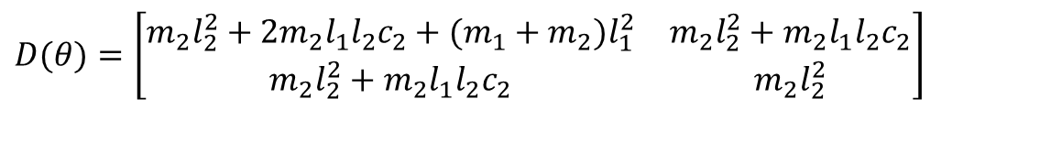
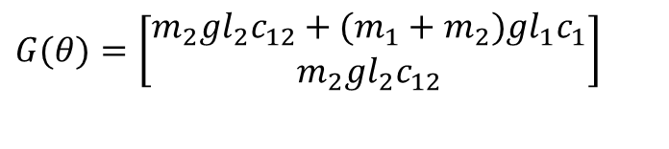
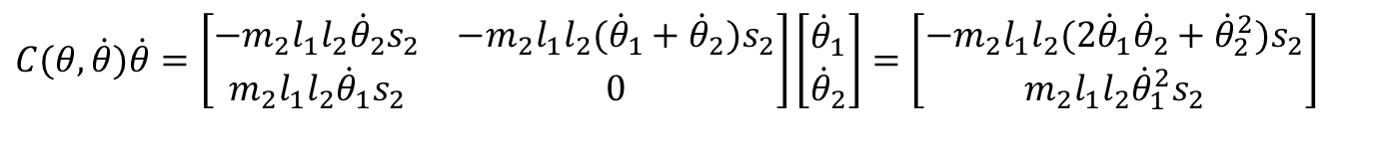
Q&A.2
Answer:
lecture note 2.1 Newton-Euler formulation p19
Eq. (2.1.3) should be
(2.1.3)
lecture note 2.1 Newton-Euler formulation p30
The dynamic equation should be
$$D(θ)=\left[\begin{matrix}m_{2}l_{2}^{2}+2m_{2}l_{1}l_{2}c_{2}+(m_{1}+m_{2})l_{1}^{2} & m_{2}l_{2}^{2}+m_{2}l_{1}l_{2}c_{2} \\ m_{2}l_{2}^{2}+m_{2}l_{1}l_{2}c_{2} & m_{2}l_{2}^{2}\end{matrix}\right]$$
$$C(θ,\dot{θ})\dot{θ}=\left[\begin{matrix}−m_{2}l_{1}l_{2}{\dot{θ}}_{2}s_{2} & −m_{2}l_{1}l_{2}{({\dot{θ}}_{1}+\dot{θ}}_{2}{)s}_{2} \\ m_{2}l_{1}l_{2}{\dot{θ}}_{1}s_{2} & 0\end{matrix}\right]\left[\begin{matrix}{\dot{θ}}_{1} \\ {\dot{θ}}_{2}\end{matrix}\right]=\left[\begin{matrix}−m_{2}l_{1}l_{2}(2{\dot{θ}}_{1}{\dot{θ}}_{2}+{\dot{θ}}_{2}^{2})s_{2} \\ m_{2}l_{1}l_{2}{\dot{θ}}_{1}^{2}s_{2}\end{matrix}\right]$$
$$G(θ)=\left[\begin{matrix}m_{2}gl_{2}c_{12}+(m_{1}+m_{2})gl_{1}c_{1} \\ m_{2}gl_{2}c_{12}\end{matrix}\right]$$

